Slide 1
Physiotherapy in Pregnancy
Pelvic, Obstetric & Gynaecological Physiotherapy: BSUH.NHS TRUST

Slide 2
The aim of the session
To understand the symptoms that you are experiencing.
To help you identify changes you can make in your daily living.
Hopefully, you will be able to download from this website an accompanying “Individual Plan “ which will help you reduce activities that are provoking your symptoms.

Slide 3
Content of Group
Explanation and risk factors of Pelvic Girdle pain
Pacing and planning
Avoiding and adapting activities specific to you

Slide 4
Will I have an individual appointment?
“If only I’d known that sooner”
Unfortunately , due to the current situation we are unable to offer face to face appointments. We do hope to be able to ring you to discuss your symptoms, depending on how quickly we as physiotherapists get deployed to the wards.

Slide 5
Will I get worse?
Please do not make the assumption that because you have symptoms now that you will automatically get worse
We aim to help you understand what you can do to help yourself with our experience and guidance
Start of your journey, putting you back in control

Slide 6
Is it just me?
Affects 1 in 5 pregnant women to varying degrees

Slide 7
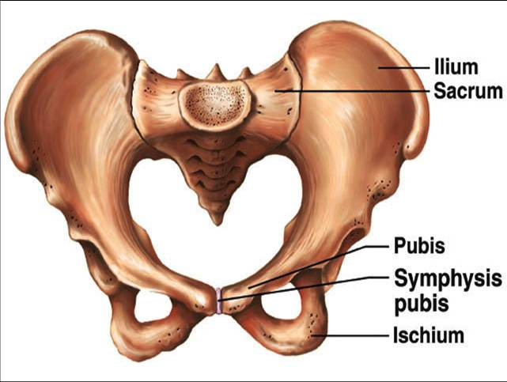
What is PGP?
Pain in the joints which make up your pelvic girdle
Diagnosis is based upon certain signs and symptoms

Slide 8
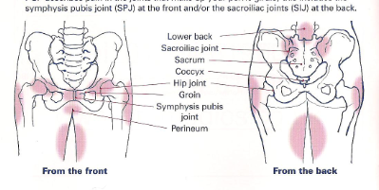
Where does it hurt?

Slide 9
Signs and Symptoms
Difficulty getting up from a chair and rolling over in bed
Difficulty walking
Pain when standing on one leg
Pain moving your legs apart, painful hip movements
Clicking or grinding noises
Difficulty lying in certain positions
Pain and difficulty during sexual intercourse

Slide 10
Causes of PGP
Usually due to a combination of factors including;
Hormones affecting ligament laxity resulting in increased range of movement
Change in muscle activity altering the general” balance” of the pelvic girdle
Altered posture
Position of the baby

Slide 11
Picture from O’Dwyer, M. (2009) Hold it Sister: The Confident Girl’s Guide to a leak-free life. Queensland: RedSok Publishing.

Slide 12
Risk Factors
Previous low back and pelvic girdle pain
More than one pregnancy
Previous pelvic injury
A hard physical job or awkward working conditions
Increased mobility of other joints

Slide 13
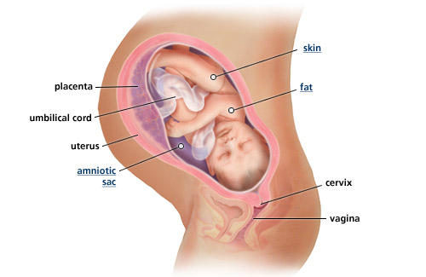
Gradual Weight Gain In Pregnancy
Blood Volume Increase-1.5kg
Fat-3.5kg
Amniotic Fluid-0.8kg
Baby-3.4kg
Breasts-0.4kg
Placenta- 0.6kg
Extra Cellular Fluid-1.4kg
Uterus Incrase-0.9kg
Which equals 12.5kg (just under 2 stone)

