Slide 1
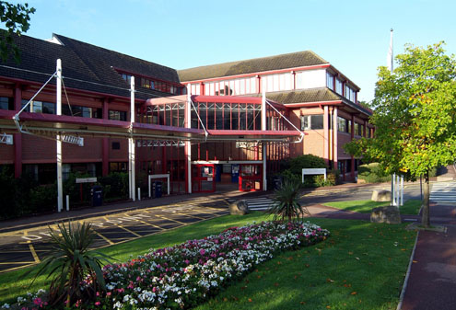
Recent HITT(High Impact Intervention Team) Observations/Findings /Themes and Discharge Planning & 80 % Simple Discharges
September 2019

Slide 2
Wards Visited
COE/Medical/Dementia
Emerald
Vallance
Specialist
L9A
L8AE
Surgical
L10
Jowers
Bristol
Chichester
AAU
Trafford

Slide 3
Encouraging findings – The Good Stuffs !

Slide 4
Analysis - Themes across wards
Ward Training – discharge planning
Admission initial assessment – social aspects
Duplication
Over – assessment
Respecting professionals input
MDT-Board Rounds -Ward rounds- process to discharges
Documentation
Culture
Simple & complex discharges (20 %) – distinguish
AAU – current model & efficacy
Alignment – input & output (Discharges) – impact on quality & safety (governance)
Outlining roles and responsibilities
Silos working
Discharge facilitator on some wards – various model – Proficient?
MDT – Boardrounds – Ward rounds – efficacy & productivity of process?
DISCO role on wards – input in d/c planning?
Resources distribution & delivery – DISCO/Therapists
Notes:
Fragmentation of resources – disparity across wards – some wards rich in regards of therapy but around 60 % of patients do not need them
HRDT model on level 5
Roles & responsibilities in an MDT – in terms of actions – can be quite blurred
Silos working – wards not aware of the bigger picture – eg ED / 12 hourly breach – electives cancellation -
Varied model of discharge delivery – not really fit the demographics of wards
Times of MDT – am – patients not yet seen by consultants -

Slide 5
Discharge planning=Simple Discharges 80 % (who are they?)
Initial admission assessment
Keeping NH & RH up to date re, their residents and problem solving approach with change of needs mainly RH ones ( Physio/OT/Equipment input)
Referrals completion such as HF/NORA/NOD
Risk assessment (Therapy) & over ax – D2A
Ward nurses & HCA input re, discharge planning – D2A principle via HF
Re-start of POC and keeping communication live with care agencies – at least 24 hours notice (Beware of Fridays !!)
PJ Paralysis – patient in bed !
Involving & Setting clear expectations – family/carer
MDT – clear structure – actions & by whom – roles & responsibilities
Think HF for B & H !

